Slide 1

Field Notes 6
Stephen Giang

Slide 2
Remember the Titans (2000)
Remember the Titans was a film that showed its audience about overcoming discrimination and displayed a theme that no matter the skin color, everyone is equal as humans. This film has a positive message about race with the knowledge that its audience members are pro-equality and against discrimination about skin color.

Slide 3

This Image represents the segregation of black and white people during this time in America. The film shows that looking closer, there is a gray area that shows equality between both races.
“Melanin Conscious America or America in Black and White.” Afripol, www.afripol.org/afripol/item/1980-poem-melanin-conscious-america-or-america-in-black-and-white.html. “

Slide 4

“What Was Jim Crow.” What Was Jim Crow - Jim Crow Museum - Ferris State University, www.ferris.edu/jimcrow/what.htm.
This was an actual sign that most restaurants had to segregate the blacks with the whites.

Slide 5
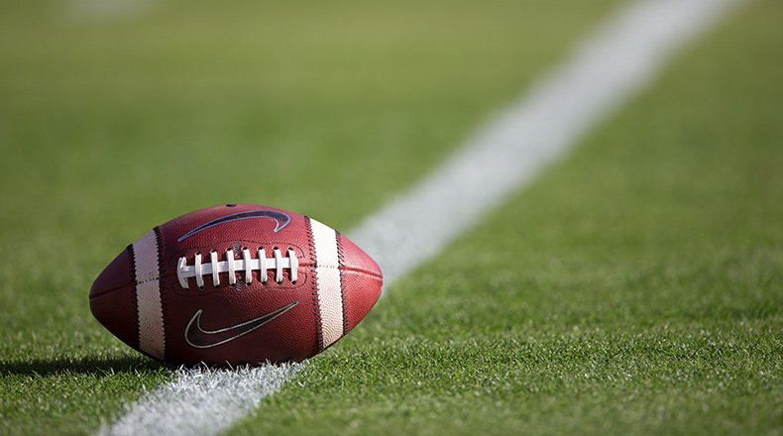
Lassan, Steven. “College Football Week 13 2020 Schedule.” AthlonSports.com, athlonsports.com/college-football/college-football-week-13-2020-schedule-games-tv-times-dates.
Football was used as the glue to join blacks and whites as Americans who love the most American sport, Football

Slide 6

“GRAY (Adjective) American English Definition and Synonyms: Macmillan Dictionary.” GRAY (Adjective) American English Definition and Synonyms | Macmillan Dictionary, www.macmillandictionary.com/us/dictionary/american/gray_1.
This Image represents the fact that black and white people are the same and should be treated equally because underneath they're all human, or in this case gray.

Slide 7
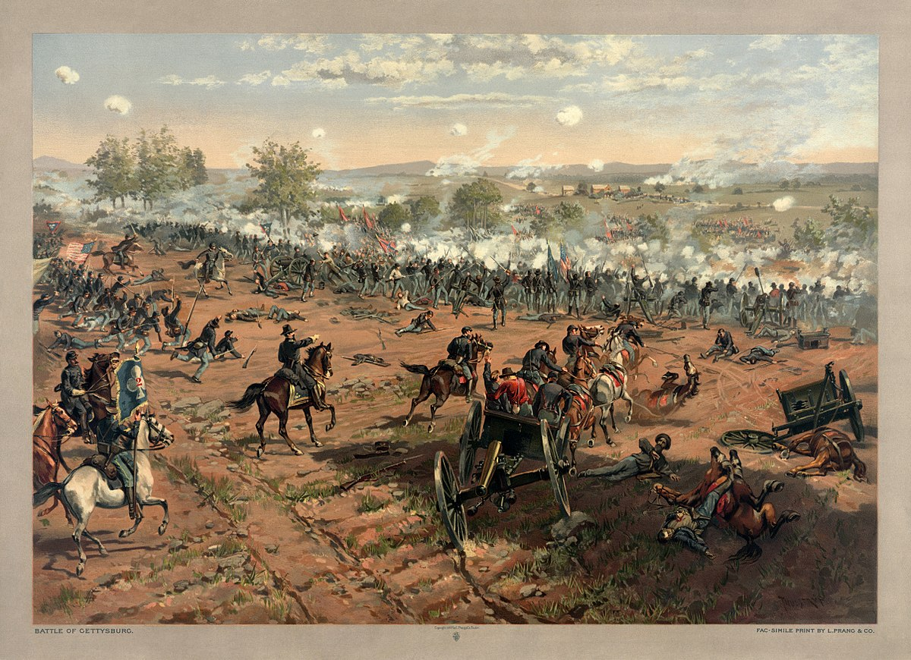
“Battle of Gettysburg.” Wikipedia, Wikimedia Foundation, 30 Mar. 2021, en.wikipedia.org/wiki/Battle_of_Gettysburg.
This was a battle between the confederates and the Union. This was a scene in the movie talking about how the war was so many years ago, and yet it still was being fought today.

Slide 8

“Opinion: Long Hospital Stays Don't Affect Only The Patient.” HuffPost, HuffPost, 3 Apr. 2018, www.huffpost.com/entry/opinion-briggs-icu-families_n_5ac2365be4b0f112dc9dd1d3.
There was a scene in the movie in which a nurse tells one of the main characters that the visitors was only for family. And the other main character told her “cant you see that this is my brother” despite the difference in skin color.

Slide 9

“Environmental Factor: Environmental Factors, Physical Activities, Health Services.” Pinterest, www.pinterest.com/pin/184999497180525069/.
Environmental factors played a huge role in the film. They showed that it was the taught racism and the parents that made the children and the teenagers racist.

Slide 10
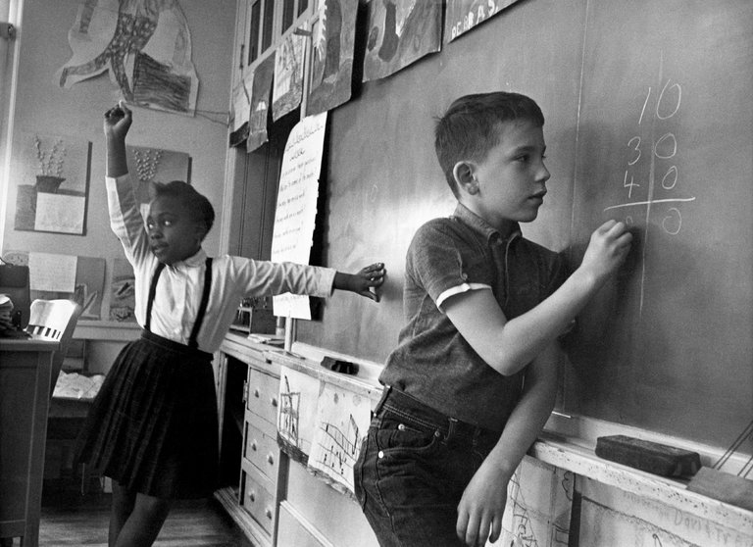
L. Swarns, Rachel, et al. “The Promise and Limits of School Integration.” The New York Times, The New York Times, 31 Jan. 2016, www.nytimes.com/interactive/projects/cp/national/unpublished-black-history/school-integration-in-princeton-nj-1964-race-racism.
This shows the integration of black and white children in schools. This was shown in the film to be very infuriating to the white parents.

Slide 11

Burks, Raychelle. “How to Break up a Christmas Party.” Chemistry World, Chemistry World, 12 Dec. 2019, www.chemistryworld.com/opinion/how-to-break-up-a-christmas-party/4010727.article.
This image represents the aggression that the white family's felt towards the new black coach yelling at their white children.

Slide 12
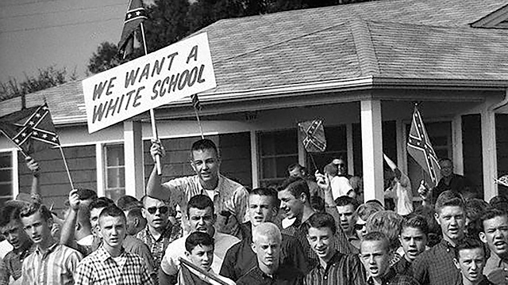
“Responses Coming from the Civil Rights Movement.” PBS, Public Broadcasting Service, www.pbs.org/wgbh/americanexperience/features/eyesontheprize-responses-coming-civil-rights-movement/.
This image was the entire them of the movie, in the fact that there was so much aggression that the blacks and whites had for each other. Until football united them.

Slide 13
Conclusion
Overall, the entire film really highlights the racism in the America and the struggle that both faced in overcoming the environmental factors. When pulled from their environment and treated as equals, they were able to truly see each other as humans and ignore race.

